Slide 1


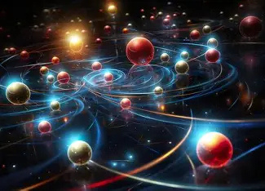
Quantum Computing
presentation
Name : Youssef Mohamed Moustafa
ID:22101287
Supervisor: Proof DR/ Ahmed Younis

Slide 2


Overview:
Research Paper & code for it.
Company (algorithmiq).
News 2025.

Slide 3
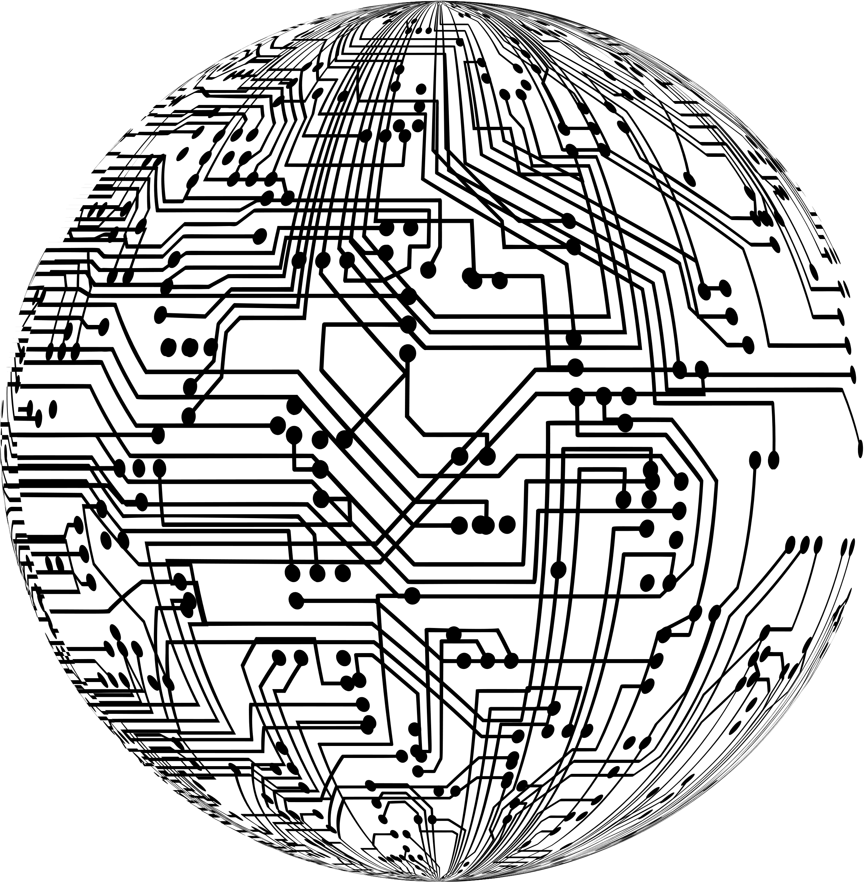
Variational Quantum Algorithms for Combinatorial Optimization
Problem: MaxCut Optimization:
MaxCut: Partition nodes of a graph into two sets to maximize the number of edges cut.
NP-hard combinatorial optimization problem.
Relevant for network design, logistics, and machine learning.

Slide 4


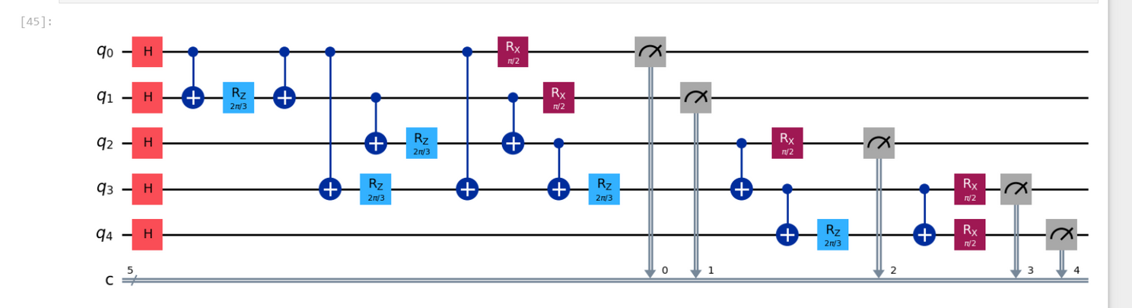
Solution Approach: QAOA
Build a parameterized quantum circuit:
Cost layer: Apply CNOT-RZ-CNOT per edge.
Mixer layer: RX rotations on all qubits.
Optimize parameters (γ, β) using classical optimizer to maximize expected cut value.

Slide 5

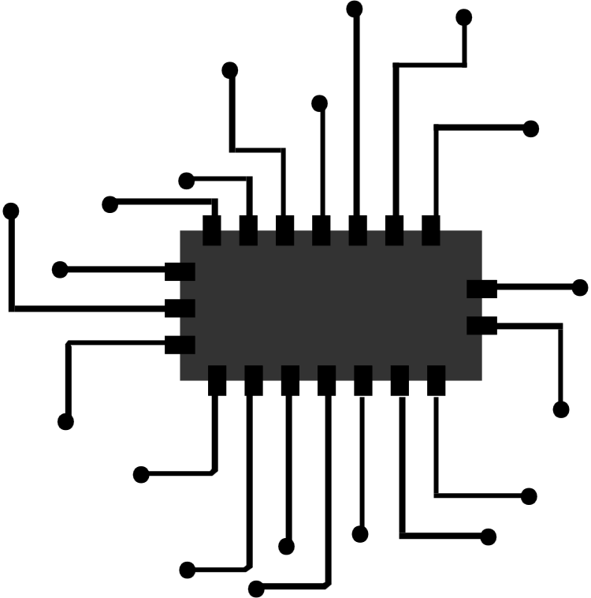
Methodology
Random graphs: Erdős–Rényi with n=10,20.
Depth p = 1,2,3.
Simulated circuits in Cirq.
Classical optimizers: BFGS (gradient-based) and Nelder-Mead (no gradient).
Compute approximation ratio: QAOA / classical max cut.

Slide 6
Results & Key Findings
QAOA achieved ~70–80% of classical solution quality.
Best average: ~0.8 for n=20, p=3 (non-gradient optimizer).
Runtime grows roughly linearly with p.
Gradient-based optimizer (BFGS) significantly faster:
- p=1 → ~2s, p=3 → ~8s (vs ~36s for Nelder-Mead).

Slide 7


My Code vs Paper
Similarities:
Differences:
Same QAOA ansatz: H → CNOT-RZ-CNOT → RX per qubit.
Uses statevector simulation for exact expectation value.
Optimizes parameters classically.
My code uses COBYLA (no gradient).
x paper used BFGS + Nelder–Mead.
I ran on 1 small graph n=5
x paper ran 100 random graphs (n=10, n=20).
I used p=1 only.
x paper explored p=1,2,3.

Slide 8

Algorithmiq Company:
“Bringing quantum to life“
Company Overview:
Name: Algorithmiq
Founded: 2020 – Helsinki, Finland
Mission: Revolutionize life sciences through quantum computing,
focusing on drug discovery, molecular design, and materials science.

Slide 9

Core Expertise & Technology:
Quantum computing for life sciences solving problems with NISQ devices.
Aurora: Quantum chemistry simulation platform
Digital Quantum Interface (DQI): Bridges quantum & classical computing.
TEM: Noise mitigation technology available via IBM Qiskit, accelerated with NVIDIA GPUs.

Slide 10


Flagship Collaborations & Impact:
IBM: Co-developing Aurora & TEM in Qiskit ecosystem
NVIDIA: GPU acceleration for TEM (up to 300× speedup)
Cleveland Clinic: Advancing quantum chemistry for cancer therapy
Large-scale experiments: 91-qubit simulations, 4,095 entangling gates

Slide 11

Leadership & Team:
Prof. Sabrina Maniscalco – CEO & Co-founder
Guillermo García‑Pérez – CSO & Co-founder
Matteo Rossi – CTO & Co-founder
Boris Sokolov – Lead Researcher & Co-founder
Diverse interdisciplinary team of physicists, chemists, and engineers

Slide 12
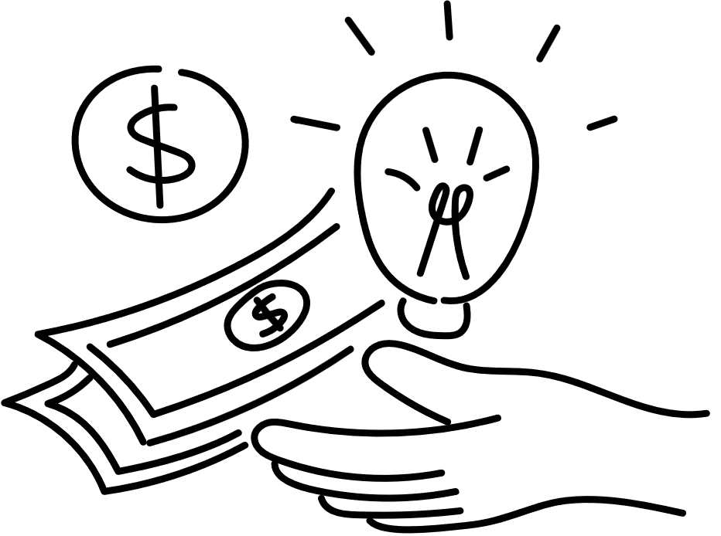
Funding & Recognition:
Seed Round (2022): $4M from Tiger Global and top angels.
Series A (2023): €13.7M from Inventure VC, Tesi, EIB, and others.
Awards: Hottest DeepTech Startup in Europe, IBM Quantum Network member.

Slide 13
Gen QAI: The Future of Quantum-Powered AI
• Quantinuum: World's largest integrated quantum company.
• Goal: Explore how quantum generated data transforms AI and industries.
Location & Date: Broomfield, CO (USA) and London, U.K., February 4, 2025

Slide 14
What is Gen QAI?
• Generative AI framework powered by quantum generated data.
• Uses Quantinuum's H2 quantum computer to produce training data.
• Significantly boosts AI model accuracy and problem-solving.

Slide 15


Why This Matters ?
• More accurate and reliable AI systems.
• Solves complex problems beyond classical computing power.
• Creates immediate commercial opportunities.
Healthcare Impact:
• Synthetic data for rare diseases improves AI training.
• Faster clinical trial simulations.
• Moves toward personalized medicine.
• Quote: 'A new era for AI unlocked by quantum technologies.' – Dr. Thomas Ehmer, Merck KGaA.

Slide 16
Collaborations & Partnerships:
• HPE Group(in Italy): Battery design, aerodynamic optimization.
• SoftBank: Commercial expansion and funding.
• Partnerships in pharma, automotive, materials science.
The Helios System:
• Launching mid-2025.
• Expands computational power exponentially.
• Focused on drug discovery and climate solutions.

Slide 17


Business & Market Impact:
• Marks transition from theory to real commercial use.
• Opportunities for AI startups, pharma, research.
• Sets new industry standard for AI model training.
Challenges Ahead:
• Integration with classical computing systems.
• Need for skilled quantum workforce.
• Scaling hardware for larger AI models.

Slide 18

Future Outlook
• More collaborations and case studies coming soon.
• Potential to revolutionize personalized medicine.
• Turning point for AI and quantum computing.

Slide 19

Reference
• https://arxiv.org/abs/2407.06421
• https://arxiv.org/pdf/2407.06421
• https://algorithmiq.fi/
• https://www.quantinuum.com/press-releases/quantinuum-announces-generative-quantum-ai-breakthrough-with-massive-commercial-potential

